Slide 1
WKRDB-EST2 Second Workshop on Estimation with the RDBES data model
On distance
14/09/2020 to 18/09/2020

Slide 2
ToRs
WKRDB-EST2 – Second Workshop on Estimation with RDBES data model
The Second Workshop on Estimation with the RDBES data model (WKRDB-EST2) chaired by Nuno Prista, Sweden and Kirsten Birch Håkansson, Denmark, will meet through a web meeting from 14 to 18 September 2020 to:
a. Development and documentation R scripts for design based estimation for each hierarchy in the RDBES data model (supporting Advice Plan: Assuring Quality);
b. Identify and document issues problems with RDBES data model relating to design based estimation (supporting Advice Plan: Assuring Quality);
c. Develop roadmap for future improvements to the estimation procedures within the RDBES;
WKRDB-EST2 will present a written report to ACOM by 18 December 2020.
Main upcoming dates with interest in RDBES-EST2 developments
RDBES data call: 30 September
WGCATCH: 9-13/November
WKRAISE&TAF: 16-20/November
SC-RDB/WGRDBESGOV: 1-3/December

Slide 3

Agenda
ToRs:
a. Development of R scripts for design-based estimation
b. Issues with RDBES data model relating to design-based estimation
c. Roadmap for future improvements of design-based estimation
Photograph: Shutterstock

Slide 4
RDBES R-Objects
RDBES
What | ObjectName (final)
RDBES extractions as .csv | TR.csv, FO.csv, ...
R list with raw data | DBErawObj
R list with prepared data (with probInc) | DBEprepObj
R list with master estimation table | DBEestimObj
R list with point estimates of totals | DBEresultsTotalPoint
R list with variance estimates of totals | DBEresultsTotalVariance
Estimates

Slide 5
RDBES R-Objects: details
R list with raw data: DBErawObj
R list with prepared data (with prob): DBEprepObj
R list with master estimation table: DBEestimObj

Slide 6
RDBES R-Objects: details
R list with point estimates of totals: DBEresultsTotalPoint
R list with variance estimates of totals: DBEresultsTotalVariance
An R-list
Input
Year, Country, Sampling Scheme
Hierarchy
Integer [e.g., 1]
Parameters
Target estimates
Results
Point Estimates
Variance Estimates
…
!
To be discussed
(what would estimators and end-users like to know?)

Slide 7
WKRDB-EST2: Test Data Sets
Common testData folder:
’Unreal’ data – sample - DK_1966_H1-13
Based on data model 1.18
Based on Dave’s functions & script – data based on allowed codes with the added posibilities of making data more realistic
Created for all hierachies (H1-H13)
Data in the RDBES upload format
Uploaded to https://sboxrdbes.ices.dk & https://github.com/ices-eg/WK_RDBES/tree/master/WKRDB-EST2/testData/output/uploaded
Data in the DBErawObj format
Uploaded to https://github.com/ices-eg/WK_RDBES/tree/master/WKRDB-EST2/testData/output/DBErawObj
Subgroup testData folder:
Create / manipulate test data that are useful for testing the functions &/| reflects relevant issues

Slide 8
WKRDB-EST2: Test Data Sets
Common testData folder:
’Real’ data – population – DK_1967_pop_H1
Based on a TRUE population
40 vessels targeting sprat on 316 Fishing trips hauls with varying number of hauls
Predominantly cathcing 1 species, but by-catch of 14 other species
Varying lower hierarchies
Data for H1
Data in the DBErawObj format
Based on data model 1.18
’Real’ data – sample 1 – DK_1967_sample_1_H1
Very small 2 PSU’s, 2 SSU’s & 2 TSU’s
SRSWR at all levels
All species sampled in the species list
Lower hierarchyType = "A"
All cases complete
Data in the DBErawObj format
Will be uploaded to https://github.com/ices-eg/WK_RDBES/tree/master/WKRDB-EST2/testData/output/DBErawObj by midday
Subgroup testData folder:
Create / manipulate test data that are useful for testing the functions &/| reflects relevant issues

Slide 9
WKRDB-EST2: Subgroups
SG1 Produce functions for data extraction and preparation of datasets Adding the probabilities and weights to the datasets
SG2 Produce function that picks up the prepared tables and creates an estimation object (master table) Create functions that run point estimation on estimation object
SG3 Compile and identify variables for variance estimation Code the variance for the univariate HH and HT estimator with the estimation object
SG4 Define structure for Species Selection handling - develop from proof of concept Produce function for data preparation of SA table
SG5 Produce function for univariate or multivariate sample data and estimation Trial estimation at sample level
SG6 Set up R-package and think about what it involves (maintenance, test environment, collaboration,…) Test inclusion of 1 function in package; incorporate other functions as they get ready
SG7 Link the subgroups, conduct full estimation
Marta, Henrik
Kirsten
Liz
Nuno
Edvin
David

Slide 10
WKRDB-EST2: Functions available (from WKRDB-EST)
Name | Who | Language | What it does | Where it can be found | Comments
v_FishingOperation.sql | Henrik | SQL | Extract data from the RDBES tables into csv files including the reference id fields | WK GitHub | View for a table used for data extract
generateZerosInSA | Nuno & Subgroup2 | R | Checks of one spp against SL and generates 0s and NAs in SA table | WK GitHub | Proof-of-concept
generateProbs | Nuno | R | Determination of inclusion probabilities | WK GitHub | generate_probs
handlingOfSubsamplingInSA.R | Nuno | R | Handles subsampling levels of SA into a single line for probInc attribution | WK GitHub | handling_of_subsampling_in_SA.R
SG1
SG4
SG1,2,4,5
SG4

Slide 11
WKRDB-EST2: Functions available (from WKRDB-EST)
Name | Who | Language | What it does | Where it can be found | Comments
read_sp_data_into_list | Kirsten | Marta | R | Reads in data from the share point, after sync to own computer. | WK GitHub | Need to made into a function
generic_su_object_upper_hie | Kristen | R | Generates an estimation object from the upper hierarchies down to the sample table (SA) | WK GitHub
h13estimator | Edvin | R | Prototype package for estimating catch at age from hierarchy 13 samples with unequal probability selection of hauls, and fish parameters recorded in lower hierarchy C. | WK GitHub | See Annex 7
Lower | Dave, Andy, Richard, Kristiina, Marijus | R | Function to create design table and probability matrix for lower hierarchies (only hierarchy A at the moment) | WK GitHub | Only basic testing done - needs to be linked to upper hierarchy and sample information.
SG1
SG2
SG1,2,3,4,5?
SG5

Slide 12
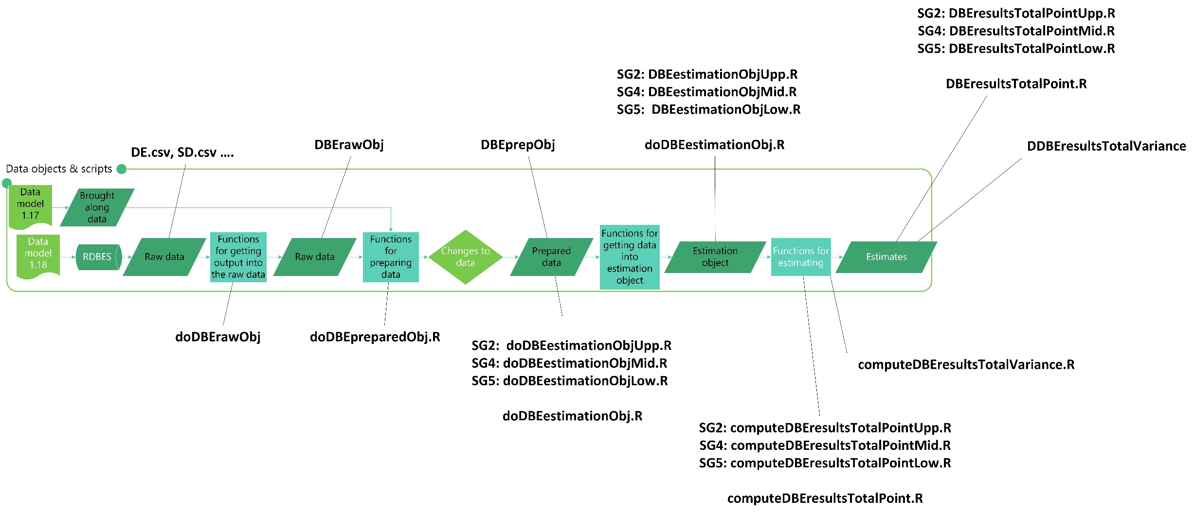
RDBES R-Objects and Scripts: in flow

Slide 13
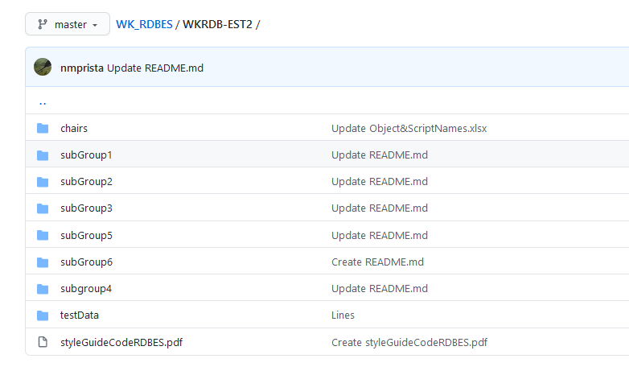
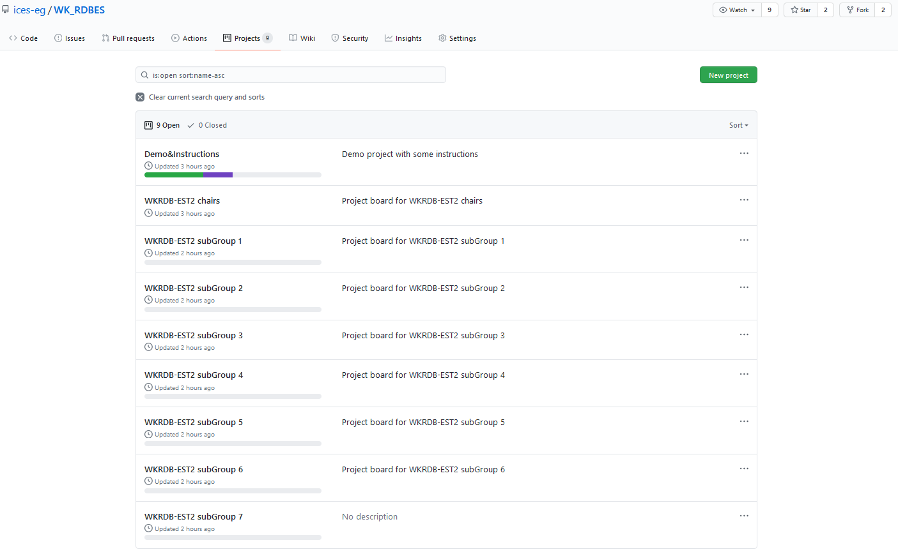
WKRDB-EST2: work on subgroups
Tools available
Microsoft Teams:
1 meeting per subgroup + 1 meeting chairs
Click on link & “step-in”; or leave message for subgroup/chairs on chat
Be nice:
Keep eye contact, use your camera if you can
Mute&unmute; Raise your hand
Arrive -5 min from time, test sound and camera
GitHub
1 folder per subgroup
1 project per subgroup
GoogleDocs:
ToR b: issues
Sharepoint
ToRs and Reporting
On distance but still an ICES WK: Close your door/email to interferences + focus on work planned

Slide 14
Distance Tools Demo
MS Teams
Chat
Websites
GitHub
File Structure
Project
Function (if&stop)

Slide 15
WKRDB-EST2: subGroup Work Organization
15-30 min SG meeting early in the day (e.g., 9:00)
Plan the work for the day, assign tasks, update project
Incorporate feedback from previous day (subgroup chairs meeting)
Throughout the day
Work individually or plenary in your tasks, update the project as you go
Use SG meeting for chat and plenaries (subgroup to decide strategy)
15-30 min SG round-up late in the day (e.g., 16:30)
Discuss developments, update project
Inform chairs of feedback to subgroup chairs meeting

Slide 16
Assign participants to subgroups:
SG1 Produce functions for data extraction and preparation of datasets Adding the probabilities and weights to the datasets
SG2 Produce function that picks up the prepared tables and creates an estimation object (master table) Create functions that run point estimation on estimation object
SG3 Compile and identify variables for variance estimation Code the variance for the univariate HH and HT estimator with the estimation object
SG4 Define structure for Species Selection handling - develop from proof of concept Produce function for data preparation of SA table
SG5 Produce function for univariate or multivariate sample data and estimation Trial estimation at sample level
SG6 Set up R-package and think about what it involves (maintenance, test environment, collaboration,…) Test inclusion of 1 function in package; incorporate other functions as they get ready
SG7 Link the subgroups, conduct full estimation
Marta, Henrik
Kirsten
Liz
Nuno
Edvin
David

Slide 17
Break-out for subgroups [30 min]
Get to know each other (get a coffee)
Look at ToRs and project
Do you understand the task ahead?
Is there something that needs clarification?
How can the ToRs be achieved?
Do you have the skills necessary?
Anything you need from others?
Discuss group functioning
How will you organize your work?
When will you meet?

